Slide 1
Predation on Coral Settlers by the Corallivorous Fireworm Hermodice carunculata
A Review
Isabelle Rennenberg
STA532

Slide 2
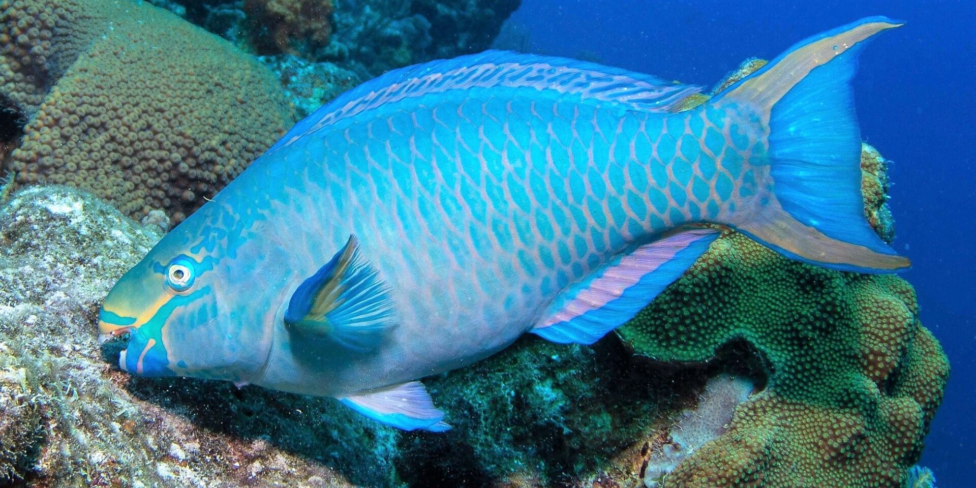
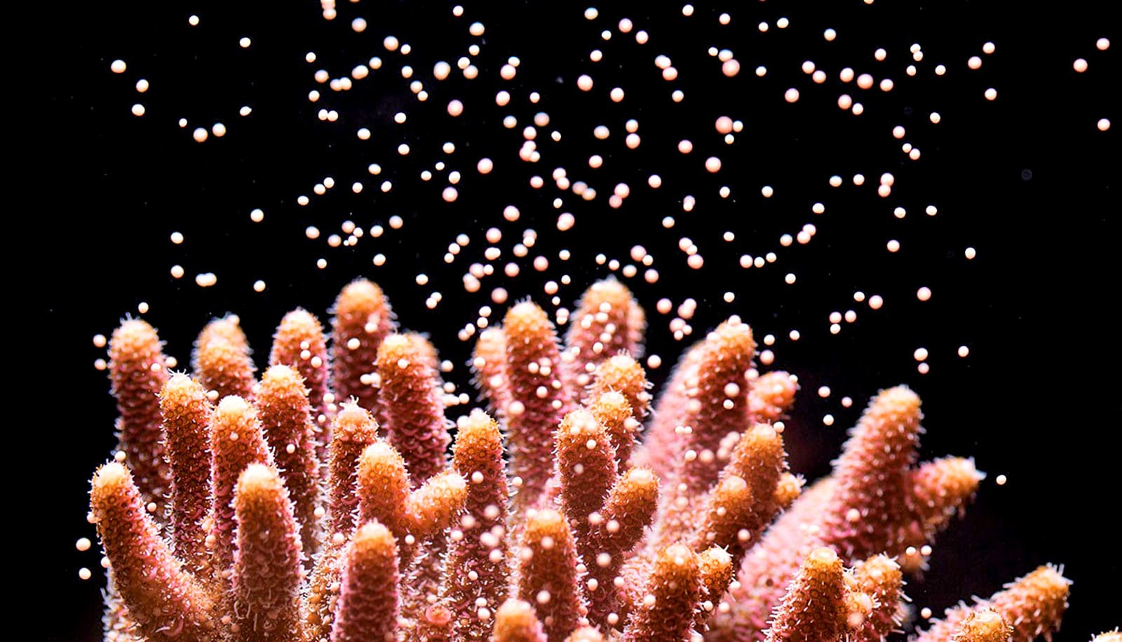
INTRODUCTION
Restoration of coral reefs is highly dependent upon coral regeneration
Damaged reefs are very reliant on larvae input
Coral larvae =prey for many species
Sea anemones, fishes, corals (corallivores)
Issues with sedimentation
Grazers help reduce algal overgrowth: can influence early-stage mortality
Not much is known about NON-GRAZING corallivores
Invertebrates: more than 50 species consume live coral tissue
Notes:
You may or may not know that coral regeneration is a very fragile process- corals can be very specific. Larvae is highly predated upon. If corals are getting harmed constantly by the water warming or other ecological disasters, and are unable to reproduce, corals will not be able to regenerate

Slide 3
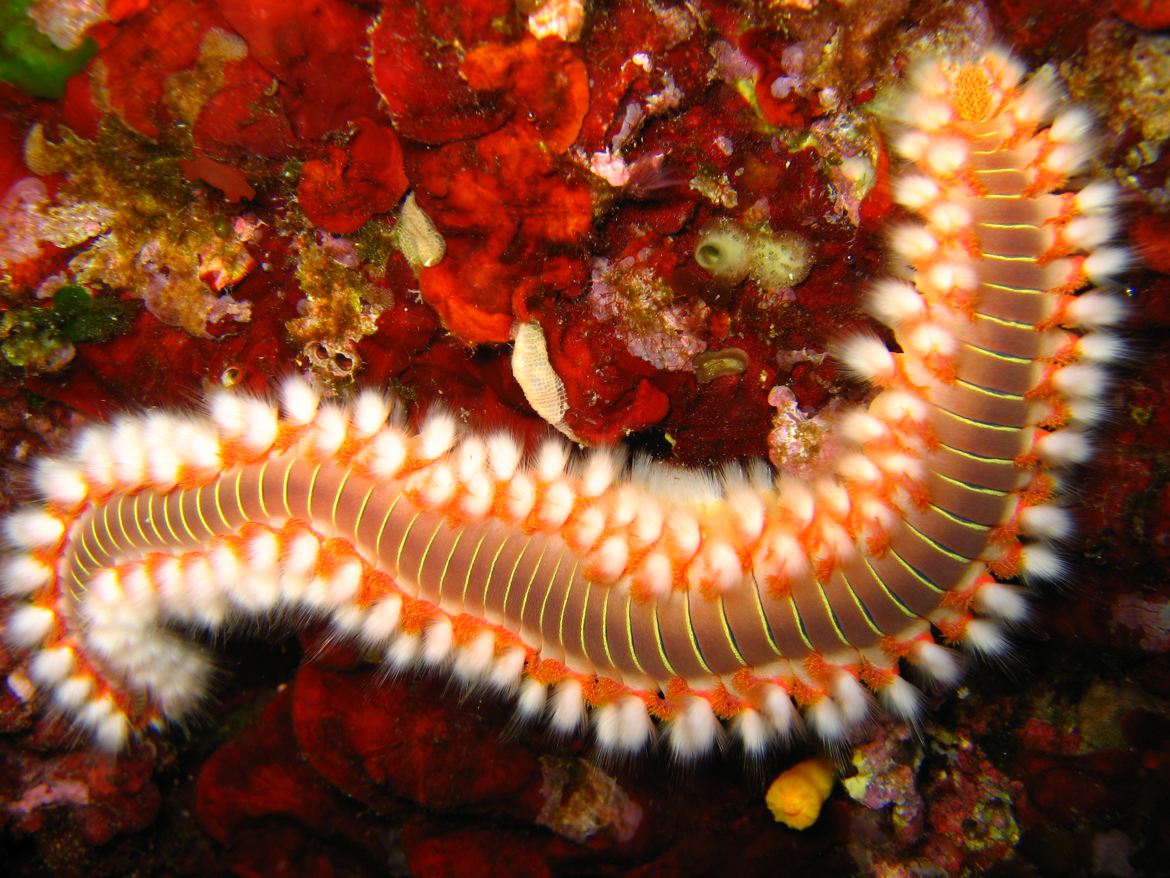
We want to Understand:
01
02
Hermodice carunculata
An amphinomid found in tropical and temperate seas – Scleractinian coral
The fireworm’s ontogenic shifts
Changing of a species diet during development
Compare predation on two species of corals, at two different ages

Slide 4
Variables of Interest
Coral
Two species, at the polyp and adult fragments
Fireworms
3 different class sizes (and control)

Slide 5
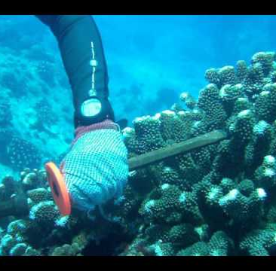
Methods
Performed in a laboratory setting
The two coral species collected:
Montastraea faveolata (broadcast spawner): 2 days old and adult
Agaricia humulis (brooder): 3 weeks old and adult
Collected from reefs adjacent to lab
The fireworms were unfed for 5 days prior
Notes:
Brooding- only male gametes are released into the water : taken in by female corals
Broadcast spawning: both male and female gametes are released into the water at the same time and fertilization occurs when they meet
Both in the primary polyp stage

Slide 6
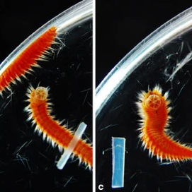
The Experimental Unit
Each experimental unit was:
10 larvae
Adult fragment
Terracotta piece
1 L container
Then randomly assigned one of four predation treatments:
1. 8 small Fireworms
2. 4 mid-sized Fireworms
3. 1 large sized Fireworm
4. No Fireworms
Time of study: 4 days , 32 containers
Notes:
Each time a worm fed on a spat, feeding duration and worm size class were recorded- corals were inspected each morning – counted under microscope – photographed for bite marks

Slide 7
Statistical Analysis Methods
Kaplan-Meier Log Rank
Difference among treatments
Holm-Sidak
Pairwise comparisons between treatments
Cox Proportional Hazard
Identification of differences in survival rates between coral species
Kruskal-Wallis
Used to analyze the difference in bite marks

Slide 8
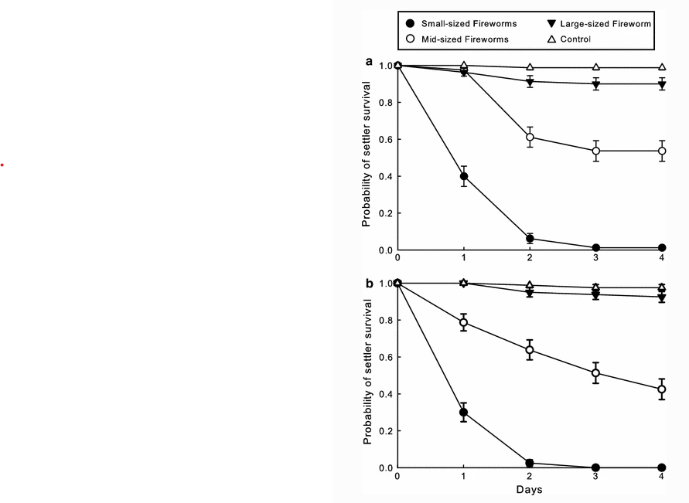
Kaplan-Meier
Montastraea
faveolata
<2%
Settler survival in the presence of small sized worms
42/54%
Settler survival in the presence of mid sized worms
93/90%
Settler survival in the presence of large sized worms
Agaricia
humilis
97%
Settler survival of the control group

Slide 9
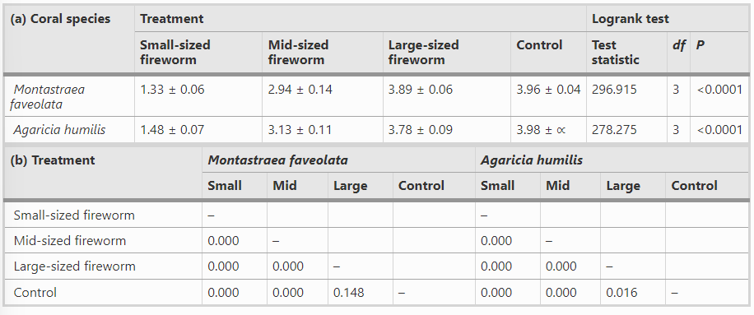
Kaplan-Meier
Holm-Sidak

Slide 10
Cox Proportional Hazard
Indicated no differences in survival rates between species of coral
Ratio: 1.16, 95% CI=0.85,1.57
Cox saturated model: X^2= 1.43, df=3, P=0.69
Kruskal-Wallis
For analysis of predation on adult coral fragments
Test: H=6.09, df=3, P>0.05 (1- way ANOVA) for both species
No differences in number of bite marks per fragment

Slide 11
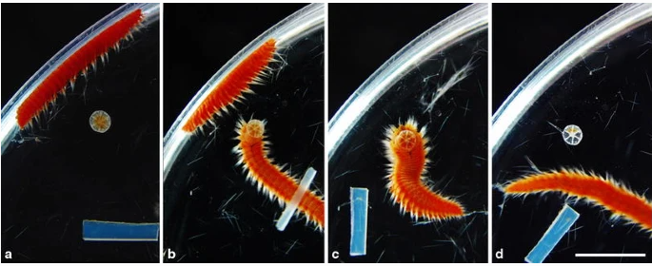
Feeding Observations
Supported results
Predation only observed on coral for small and mid sized worms
Mid=intermediate behavior
Large=pass
Encounters were fortuitous
Moved without changing direction
Feeding durations:
M. faveolata
9.2+/- 0.5 min for small
4.5+/-0.3 min for med
A. humilis
9.7+/-0.7 for small
4.0+/-0.6 min for med

Slide 12
Conclusions
Ontogenic Shifts
Causes of these changes?
Results support an ontogenic shift in the diet of H. carunculata
Remain to be investigated
Coral Age
Laboratory setting
There was also a difference in coral susceptibility to predation between larvae and adults
Lacked ecologically realistic conditions
Application to the field

Slide 13
Study Limitations
Justification and data from the cox proportional model was not presented
Censoring was not discussed in the paper. Only 97% survival for the control
Justification
Censoring
02
04
01
03
Models
Small Sample Size/No Covariates
There was no discussion of other models present in the paper- could parametric have worked?
This was a very small scale experiment, while holding all other ecological covariates constant

Slide 14
References
Wolf, A.T., Nugues, M.M. Predation on coral settlers by the corallivorous fireworm Hermodice carunculata . Coral Reefs 32, 227–231 (2013). https://doi.org/10.1007/s00338-012-0969-x
Coral Health and Monitoring Program (n.d.). CORAL SPAWNING -- BACKGROUND. Retrieved June 20, 2023, from https://www.coral.noaa.gov/education/spawning-background.html

Slide 15
Thank you!

